Slide 1
The Salvation of the Soul

Slide 2
Salvation of the Soul
1 PETER
What is the Salvation of the Soul?
The Salvation of the soul is the total transforming work of God upon our lives, which is presently being realized in the midst of Christ like suffering, and which in the future will be unveiled in Christ like glory.

Slide 3
Salvation of the Soul
1 PETER
What is the Salvation of the Soul?
The Salvation of the soul is the goal our faith, but we are actually in the process presently realizing it through suffering and learning submission.

Slide 4
Salvation of the Soul
1 PETER
What is the Salvation of the Soul?
“But may the God of all grace, who called us to His eternal glory by Christ Jesus [our future goal], after you have suffered a while, [our present reality] will make you perfect, establish, strengthen, and settle you [the salvation of the soul] ” (1 Peter 5:10)

Slide 5
Salvation of the Soul
1 PETER
Comparison
Chart

Slide 6
Life “zoe” Salvation
Soul “psuche” Salvation
Is Eternal Life
Is Abundant Eternal Life
Length / Span / Extent
Depth – Quantity and Quality
Immediate Present Possession
Future Possession
Saved from Eternal Death; 2nd Death; Hell; Perishing
Saved from Physical Death and Eternal Loss of Rewards
Received as a Gift from God
Profited by Godly Living
Accepted as a Child of God
Approved as a Obedient Child
One Condition
Many Conditions
“By Faith Alone in Christ Alone” Coming to Christ
Persevering in Good Works Abiding in Christ

Slide 7
Salvation of the Soul
1 PETER
Outline

Slide 8
Salvation of the Soul
1 PETER
Body: Salvation of the Soul, Worked out in Experience – 1:13 – 4:19
In Relation:
to God – 1:13-21
to Brethren – 1:22 – 2:10
to the World – 2:11 – 3:7
to Life Itself – 3:8 – 4:6
to the Consummation of History – 4:7-19

Slide 9
Salvation of the Soul
1 PETER
Body: Salvation of the Soul, Worked out in Experience – 1:13 – 4:19
In Relation:
to the World – 2:11 – 3:7
through Abstinence from the Lust of the Flesh – 2:11
through Honorable Conduct – 2:12

Slide 10
Salvation of the Soul
1 PETER
Soul Salvation:
When a believer abstains from a sensual worldly life and lives honorably he experiences the salvation of the soul consisting in deliverance from suffering, grief, defeat and the loss of temporal and eternal blessing for the ultimate glory of God.
Notes:
A believer who saves his soul by postponing personal gratification now knows that in the end it is not really lose proposition, because he knows what David said in Psalm 16:11, “In the Lord’s presence is fullness of joy; At Your right hand are pleasures forevermore.”

Slide 11
Salvation of the Soul
1 PETER
Body: Salvation of the Soul, Worked out in Experience – 1:13 – 4:19
In Relation:
to the World – 2:11 – 3:7
through Subjection – 2:13 – 3:7
Subjects to Civil Authorities – 2:13-17
Slaves to Masters – 2:18-25
Wives to Husbands – 3:1-7
Notes:
There are three natural divisions: first is general submission to every human institution (2:13-17); second, specific submission of slaves to masters (2:18-25); and third specific submission of wives to husbands (3:1-7). These basic social relationships are the result of believers being in the world, but we are not to be of the world. Our conduct is to set apart from the world in which we live. We are like a boat in the water, attempting to keep water out of the boat. It’s when we get water/world in the boat that’s a problem.
Peter has in mind primarily our dealings with the unsaved (saved slaves with unsaved masters or saved wives with unsaved husbands). It has been suggested that these categories were chosen because slaves and women made up the majority of converts in the early church.
“Three areas of subjection are covered by Peter. He writes about submission in public affairs, professional affairs and private affairs. Subjection is to permeate public life, the home (house slaves) and the family. Each area becomes more personal and is a deeper more difficult subjection. Peter sets up the model of Christian subjection beginning from the outward and most visible to the inward and most private.” (Hodges, p. 50)
This current age is the only time that we can learn what it means to be submissive, since during the Kingdom we will be ruling with Christ. We will be able to teach others what it means to be submissive, because we practiced it ourselves at a time when it was most difficult.

Slide 12
Salvation of the Soul
1 PETER
Soul Salvation:
When a believer subjects himself to all civil authority for the Lord’s sake, he receives the praise of those who do good, and by doing good he silences the ignorance of the foolish, also by honoring all who honor is due, by loving the brethren and fearing God.

Slide 13
Salvation of the Soul
1 PETER
Body: Salvation of the Soul, Worked out in Experience – 1:13 – 4:19
In Relation:
to the World – 2:11 – 3:7
through Subjection – 2:13 – 3:7
Subjects to Civil Authorities – 2:13-17
Slaves to Masters – 2:18-25
Wives to Husbands – 3:1-7

Slide 14
Salvation of the Soul
1 PETER
In Relation to the World - 1:22 – 3:7
Through Subjection of Slaves to Masters – 2:18-25
With Fear - 2:18
With Patient Suffering - 2:19-20
With Christ as Our Example Who Suffered with Fear and Patients - 2:21-25
Notes:
Having address the Christian’s responsibilities to the world in general, Peter now turns to more specific areas, beginning the work place as it applies to us today.

Slide 15
Salvation of the Soul
1 PETER
In Relation to the World - 1:22 – 3:7
Through Subjection of Slaves to Masters – 2:18-25
“Servants, be submissive to your masters with all fear, not only to the good and gentle, but also to the harsh.” (2:18)
Notes:
“servants” – “oiketai”, not “doulos” the most common term for slaves. Here Peter addresses household or domestic servants.
“be submissive”; “be subject” - “hupotasso” – to place or arrange under in an orderly manner.
Peter challenges Christian slaves to a new behavior which requires them to submit to and respect even those who are harsh. A large percentage of the early church was made up of servants or slaves, and undeserved punishment and suffering was common among them.
Servants are to be submissive to their masters “despotes” with fear, the same kind of fear believers are to have for God. Believers are to serve employers with same willingness and reverence with which they serve God, whether they were good and gentle or harsh.
“harsh” – crooked or perverse; curved or bent; not straight.

Slide 16
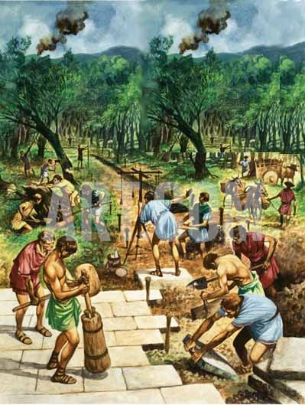
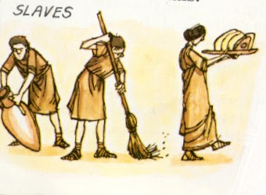
Salvation of the Soul
1 PETER
Servants in Rome
30 to 40% of the Population
Slaves as a form of Punishment
Slaves Captured in Roman Expansion
Types of Slaves: Household, Publicly
Owned, Imperial, and Bond Slaves.
Slaves could Purchase their Freedom
Notes:
Slaves made up of 30 to 40% of the Roman population.
“Unskilled slaves, or those sentenced to slavery as punishment, worked on farms, in the mines, and at mills; their living conditions were brutal, and their lives were short. Slaves were considered property under Roman law and had no legal personhood.” (Wikipedia, Slavery in Rome)
Slaves played important roles in the society. Slaves provided manual labor, domestic services and might be employed at highly skilled professions such as accountants, tutors, and physicians.
Slaves could be subject to corporate punishment, sexual exploitation, torture and execution. Over time, they gained increase legal protection, including the right to file complaints against their masters.
A major source of slaves came from soldiers captured in Rome’s military expansion, many were employed as gladiators. They were considered the most dangerous.
There were estimate to be about 55 different jobs a household slave might have. A large elite household might be supported be a staff of hundreds. Living conditions were general inferior to those who were free, but sometimes they may be superior than the urban poor in Rome. A strong, healthy and happy slave were more valuable and more productive.
Household slaves likely enjoyed the best living conditions, next to publicly owned slaves. Imperial slaves were attached to the emperor’s household.

Slide 17
Salvation of the Soul
1 PETER
In Relation to the World - 1:22 – 3:7
Through Subjection of Slaves to Masters – 2:18-25
“For this is commendable, if because of conscience toward God one endures grief, suffering wrongfully.” (2:19)
Notes:
Peter now explains why they are to submit themselves respectfully especially to their harsh, unreasonable masters. It is so they can have a clear conscience toward God, not their masters.
English - “commendable; praiseworthy; admirable” “an attractive quality in our lives” – Greek “charis” – grace, favor. “Grace” does not always mean “unmerited favor”. “commendable” “charis” - “it is the credit or approval we have before God.
Πετερ ισ σαψινγ τηατ Γοδ αππροϖεσ οφ Χηριστιανσ ωηο ενδυρε γριεφ (παιν, σορροω) ωηεν τηεψ εξπεριενχε υνϕυστ συφφερινγ.

Slide 18
Salvation of the Soul
1 PETER
In Relation to the World - 1:22 – 3:7
Through Subjection of Slaves to Masters – 2:18-25
“For what credit is it if, when you are beaten for your faults, you take it patiently? But when you do good and suffer, if you take it patiently, this is commendable before God.” (2:20)
Notes:
Peter now explains what he means by stating it negatively. Patience endurance of well-deserved punishment is expected.
There are two ways we can suffer – 1) from our faults, or 2) by our good deeds.
“faults” – “hamartano” “to fall short” – “all have sinned”; “fallen short of the glory of God” If you are punished for falling short of your duties there is no favor or approval from God.
There is no “credit”; “glory”, praise, or recognition for receiving punishment or suffering for what you deserve. But it is only worthy of praise or to your credit if you do good and suffer “pascho” for it.
Luke 6:32-36
“But if you love those who love you, what credit is that to you? For even sinners love those who love them. And if you do good to those who do good to you, what credit is that to you? For even sinners do the same. And if you lend to those from whom you hope to receive back, what credit is that to you? For even sinners lend to sinners to receive as much back. But love your enemies, do good, and lend, hoping for nothing in return; and your reward will be great, and you will be sons of the Most High. For He is kind to the unthankful and evil. Therefore be merciful, just as your Father also is merciful.”
Only displaying a good attitude while suffering unjustly after doing good is commendable before God.
On the one hand we avoid suffering by abstaining fleshly lust and living godly lives, and not receiving the natural consequence of doing so. On the other had living godly lives brings unjust suffering into our experience. Both current experiences though results in the salvation of our soul.

Slide 19
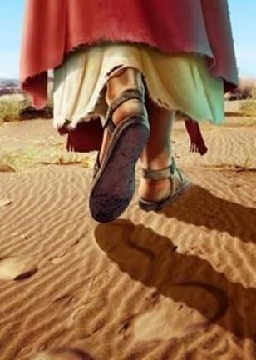
Salvation of the Soul
1 PETER
In Relation to the World - 1:22 – 3:7
Through Subjection of Slaves to Masters – 2:18-25
“For to this you were called, because Christ also suffered for us, leaving us an example, that you should follow His steps:”
(2:21)
Notes:
Peter explains next why “for” we should have a good attitude when we suffer unjustly.
“you were called” to suffer “pascho”. We were called to suffer? NO! Everyone suffers. We were not called to just suffer. – “This is a hurting world. “There are a lot of hurting people out there.” – But we are called, to patiently endure unjust suffering. This is what we are called or invited to do. It is by the grace of God that we are called to experience Christlike suffering.
Christ left us an example “hupogrammos” “a pattern”; a “writing copy”. “From His experience and example, we learn the ABC’s of godly suffering.” We follow upon His steps.

Slide 20
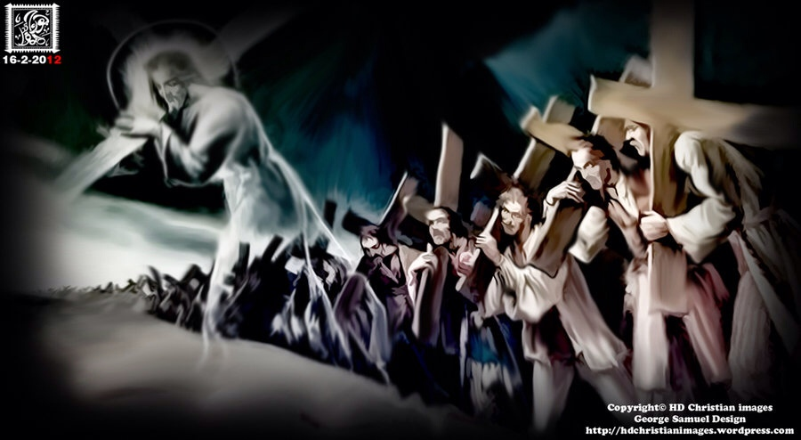
Salvation of the Soul
1 PETER
We are called to patiently endure unjust suffering just as Christ showed us the way to suffer.
Notes:
He not only is the way, the truth and the life, but also shows us the way to suffer, to die, to live. We follow Him in the way to suffer. Christ’s suffering is the model on how to respond to injustice, for He experience the greatest injustice of all.

Slide 21
Salvation of the Soul
1 PETER
In Relation to the World - 1:22 – 3:7
Through Subjection of Slaves to Masters – 2:18-25
“Who committed no sin, nor was deceit found in His mouth’; who, when He was reviled, did not revile in return; when He suffered, He did not threaten, but committed Himself to Him who judges righteously;…” (2:22-23)
Notes:
“The first step in imitating Christ is the avoidance of sin and deceit prior to suffering. We must have clean lives and lips. Peter quotes Isaiah 53:9. Jesus committed no sin, either before or during His suffering. He was completely innocent in both deed and word: “no deceit was found in His mouth”. He uses synonymous parallelism to state the same truth twice, but it different words.
2 Cor. 5:21
“For He made Him who knew no sin to be sin for us, that we might become the righteousness of God in Him.”
Heb. 4:15
“For we do not have a High Priest who cannot sympathize with our weaknesses, but was in all points tempted as we are, yet without sin”

Slide 22
Salvation of the Soul
1 PETER
In Relation to the World - 1:22 – 3:7
Through Subjection of Slaves to Masters – 2:18-25
“Who committed no sin, nor was deceit found in His mouth"; who, when He was reviled, did not revile in return; when He suffered, He did not threaten, but committed Himself to Him who judges righteously;…” (2:22-23)
Notes:
“The second step is an avoidance of reviling and threat during suffering.” Peter gives the perspective of others of which he was an eyewitness. Everything Jesus said and did was true and honest.
He was reviled at His trials when the guards beat Him and mocked Him as King. He was mocked by the Jewish leaders and one of the robbers. Even though He had twelve legions of angels at His disposal Jesus did not threaten His enemies. Rather, He prayed for them (Lk. 23:34)

Slide 23
Salvation of the Soul
1 PETER
In Relation to the World - 1:22 – 3:7
Through Subjection of Slaves to Masters – 2:18-25
“Who committed no sin, nor was deceit found in His mouth"; who, when He was reviled, did not revile in return; when He suffered, He did not threaten, but committed Himself to Him who judges righteously;” (2:22-23)
Notes:
“The third step is to develop an attitude of trust in God concerning suffering. We must have a clean character before suffering, calm conduct during suffering and a complete commitment regarding suffering.” (Hodges, p. 52)
He “committed” meaning “He was given over”, used to constantly describe in the Gospels with reference to Christ’s betrayal, He was handed over. When Christ was handed over, He handed over Himself to God. He not only handed Himself over, but His whole circumstances were delivered over to God.
Jesus handed over Himself to God in His prayer in the Garden by submitting Himself to the Father’s will (Mt. 26:39, 42). On the cross he handed over His spirit into the Father’s hand (Lk. 23:46)
Jesus handed over Himself to God. So should we in times of trouble.

Slide 24
Salvation of the Soul
1 PETER
In Relation to the World - 1:22 – 3:7
Through Subjection of Slaves to Masters – 2:18-25
“who Himself bore our sins in His own body on the tree, that we, having died to sins, might live for righteousness — by whose stripes you were healed.” (2:24)
Notes:
Rather than reviling or threatening, Jesus bore our sins in His body as He died on the cross. “…He has taken all our trespasses out of the way, having nailed it to the cross.” (Col. 2:13-14)
Notice the word, “that” called a “hina” clause, which signifies purpose. This verse goes deeper into the question of undeserved suffering. While verse 22-23 present the manner in which Christ suffered, verses 24-25 presents the motive for His suffering. He “Himself” (stresses personal involvement) carried our sins in His own body, “that we might live for righteousness.” He died for our sins so that we would live rightly, that was His purpose and motive for bear our sins on the cross.
His death makes it possible for sinners to be free from both the penalty of sin and the power of sin and to live for Him. “Christ suffered so it would be possible for Christians to follow His example, both in suffering and in righteous living.” (The Bible Knowledge Commentary”, p. 848.)

Slide 25
Salvation of the Soul
1 PETER
In Relation to the World - 1:22 – 3:7
Through Subjection of Slaves to Masters – 2:18-25
“who Himself bore our sins in His own body on the tree, that we, having died to sins, might live for righteousness — by whose stripes you were healed.” (2:24)
Notes:
Peter then quotes Isaiah 53:5 “by whose stripes you were healed” - “stripes”. “molops” is a “blow-mark” - the wound mark produced by the chastisement of slaves. It does not refer to physical healing for the verbs past tense indicates completed action, the healing is an already accomplished. This is a reference to eternal salvation. Christ’s suffering and death accomplishes the possible spiritual “healing” of every individual who trusts Him as their Savior.

Slide 26
Salvation of the Soul
1 PETER
In Relation to the World - 1:22 – 3:7
Through Subjection of Slaves to Masters – 2:18-25
“But He was wounded for our transgressions, He was bruised for our iniquities; The chastisement for our peace was upon Him, — by whose stripes you were healed.” (Isaiah 53:5)
Notes:
Isaiah uses synonymous parallelism, making four statements to describe forgiveness of sins, through the death of the coming Messiah, the Suffering Servant. They all describe the same thing. Also “transgressions” and “iniquities” are parallel as well as “peace” and “healed”. Healed refers to the forgiveness of sins, not the remission of disease. Christians do not escape the effects of disease, nor is peace automatic.

Slide 27
Salvation of the Soul
1 PETER
In Relation to the World - 1:22 – 3:7
Through Subjection of Slaves to Masters – 2:18-25
“For you were like sheep going astray, but have now returned to the Shepherd and Overseer of your souls.” (2:25)
Notes:
Christ not only set the example and provides salvation, but He also gives guidance and protection to those who were heading away from Him, who then turn to the Shepherd and Overseer of their “psuche”. This is the Chief Shepherd/Pastor and Overseer “episkopos” “Bishop” – that is the manager who cares for our lives. When we turn now to follow the Shepherd we yield to the guidance and oversight (authority) of the One who can lead our soul through the suffering to the glory which we will receive at His revelation.

Slide 28
Salvation of the Soul
1 PETER
In Relation to the World - 1:22 – 3:7
Through Subjection of Slaves to Masters – 2:18-25
“For you were like sheep going astray, but have now returned to the Shepherd and Overseer of your souls.” (2:25)
Notes:
“returned” – “epistrepho” is used in the Scriptures in both a physical or spiritual sense.
It is not the Greek word “metanoeo” - “to repent”.
When straying sheep (Isa. 53:6a) hear the voice of their savior calling them to believe and receive it, they then, turn to follow Him. The believing precedes turning. Turning occurs after believing. They are not synonymous.

Slide 29
Salvation of the Soul
1 PETER
Conclusion

Slide 30
Salvation of the Soul
1 PETER
Unjust Suffering
Vicarious Suffering
“He who did not sin”
“He who bore our sins”
They go together in Christlike Suffering
You should follow in His steps
Our Example
Our Savior
Notes:
Looking at the entire passage of 2:21-25 we see that Christ is the example of unjust suffering (22-23) and vicarious suffering (24-25), as “He who did no sin” is contrasted with “He who bore our sins”. They go together in Christlike suffering. And we should follow in His steps.
When the next time we feel unfairly treated, persecuted, suffer maltreatment for our association with Christ or Christianity in general lets see how our little footprints of suffering fit into the large and magnificent steps of our Lord, who unjustly suffered for us.
A second reason why as his servants we should bear injustice, that is, we do so because of what he did for us. His servants suffer patiently out of conscience toward God because Christ is our example (22-23) and He is our Savior (24-25).
By suffering injustice patiently as Christ did, we are currently saving our soul, for a future glory that is to be revealed. This is the salvation of the soul.

